Slide 1
Neapolitan Fantastic Beasts Biodiversity in Campania region

Slide 2
When?
18-25 May 2017

Slide 4
Activities

Slide 5
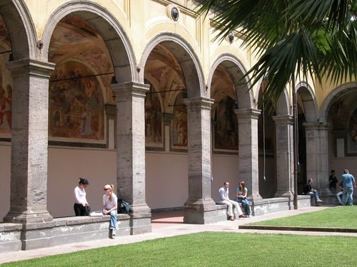
18 May
Arrival and Welcome Party in the Department of Veterinary Medicine and Animal Production of University of Naples Federico II.

Slide 6
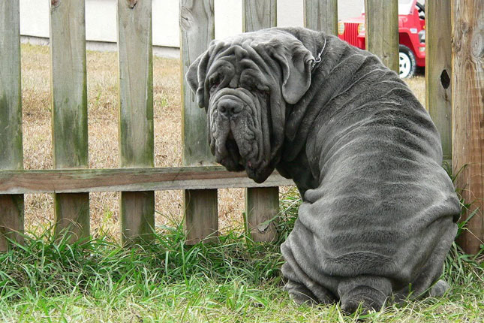
19 May
SMALL ANIMAL PRACTICE
Neapolitan Mastiff , history and clinical problems.
Prof. Leonardo Meomartino, Radiology unit,and Prof. Gerardo Fatone, Surgery unit.

Slide 7
20 May
Discovering Pompei .

Slide 8
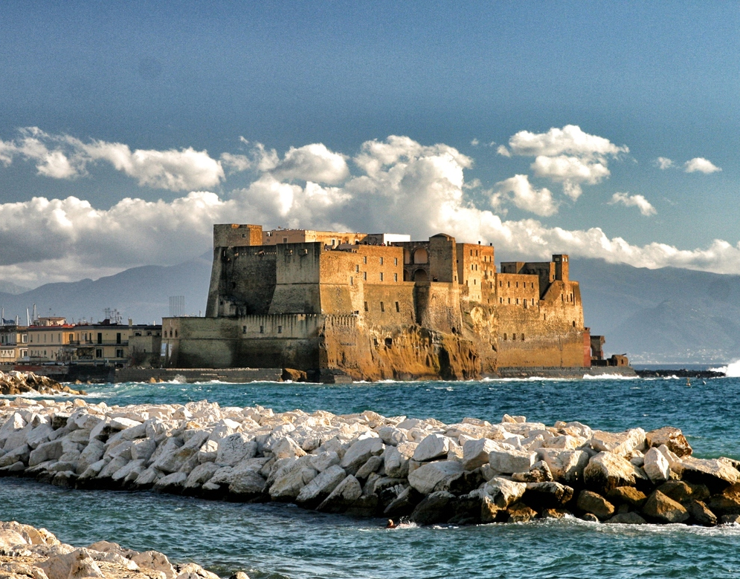
21 May
Discovering Naples

Slide 9
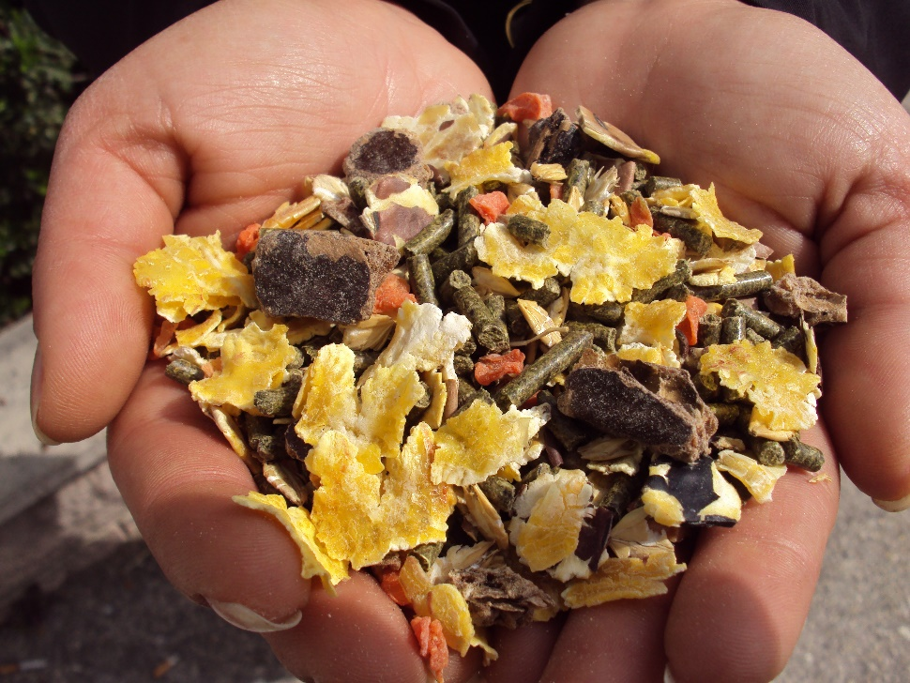
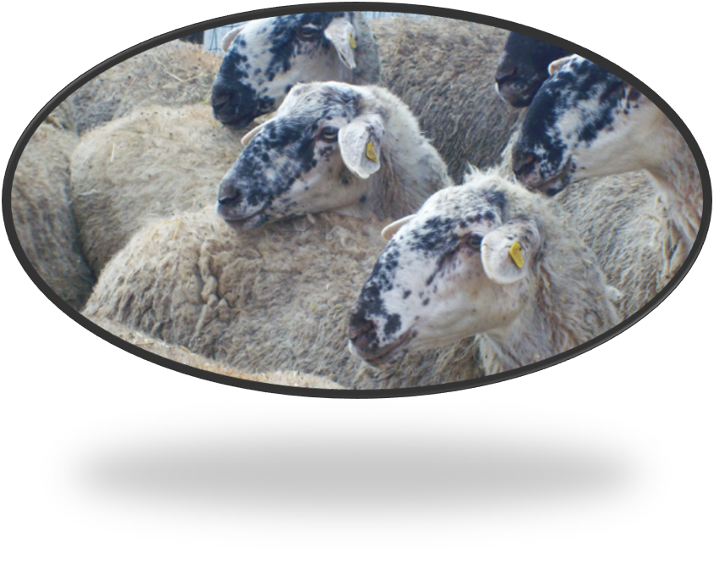
22 May
Visiting Liverini Animal Feed Company.
Avellino,
Bagnolese Sheep farm.

Slide 10
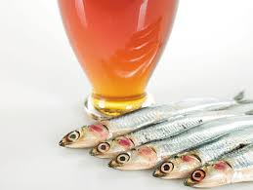
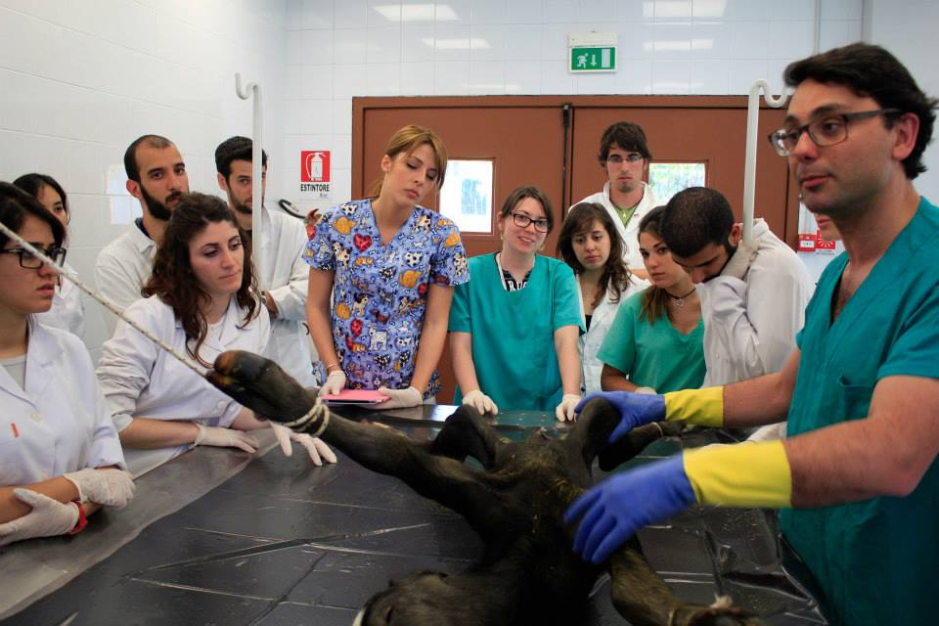
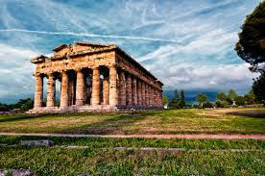
23 May
Capezzano, Anchovy Colatura in a farm.
Necropsy and Parasithologic workshop at CREMOPAR , Salerno.
Sightseeing Paestum.

Slide 11
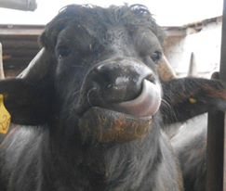
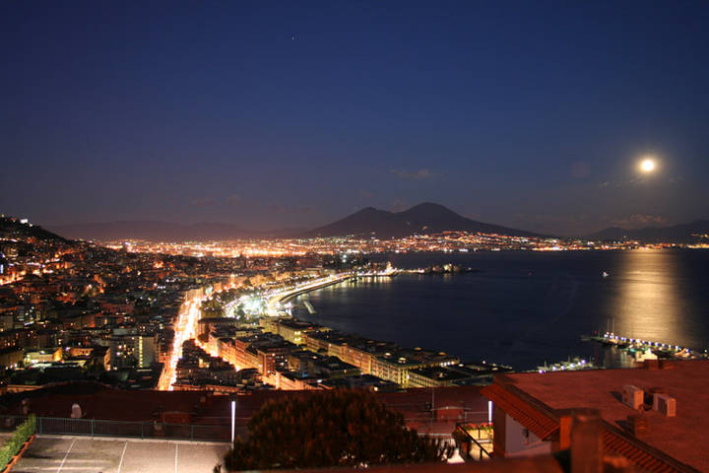
24 May
Caserta, Mediterranean Buffalos’farm.
Farewell party.

Slide 12
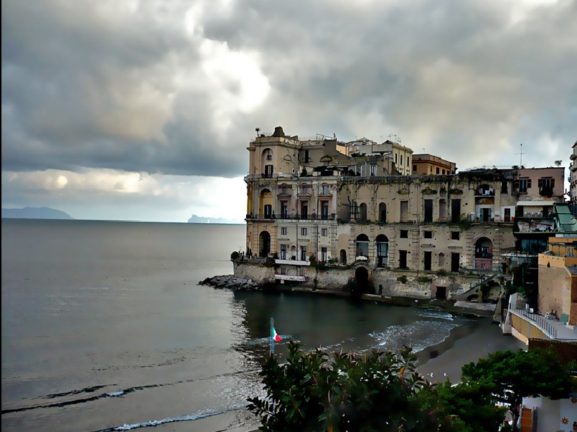
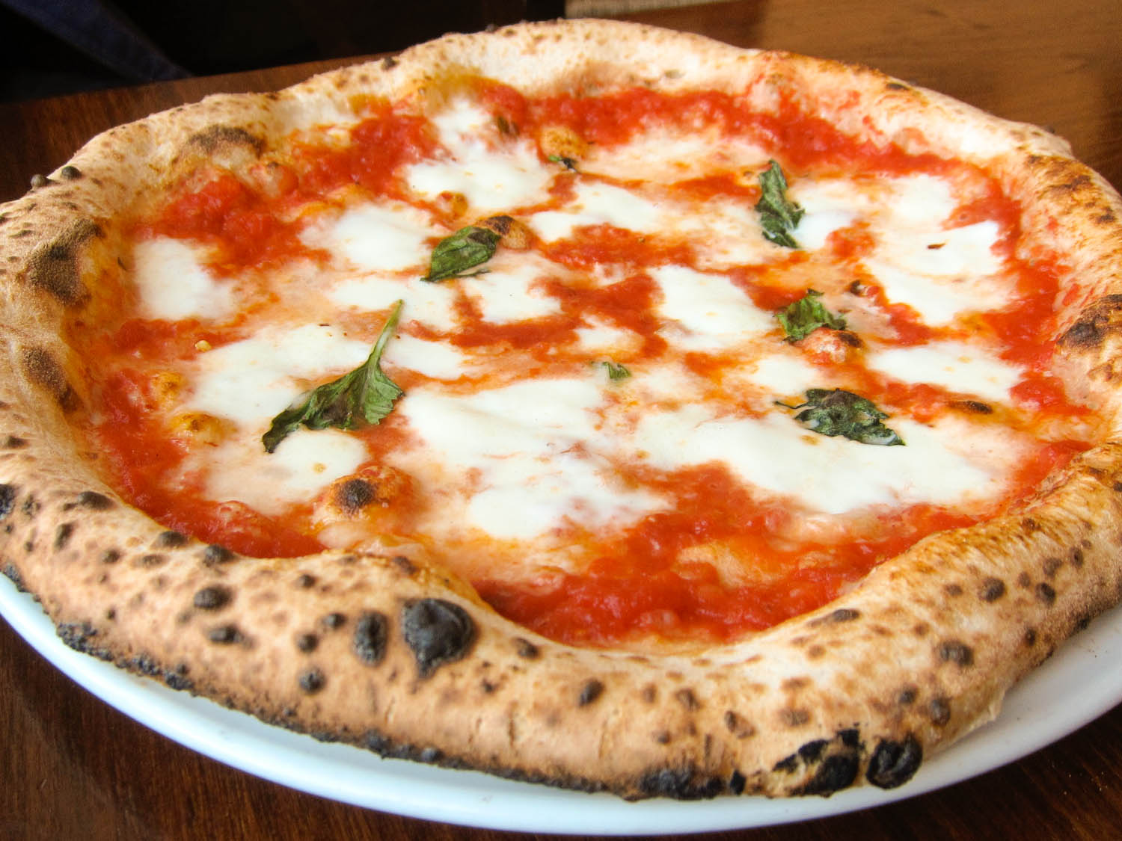
Sightseeing in Naples during free time and taste its products!

Slide 13
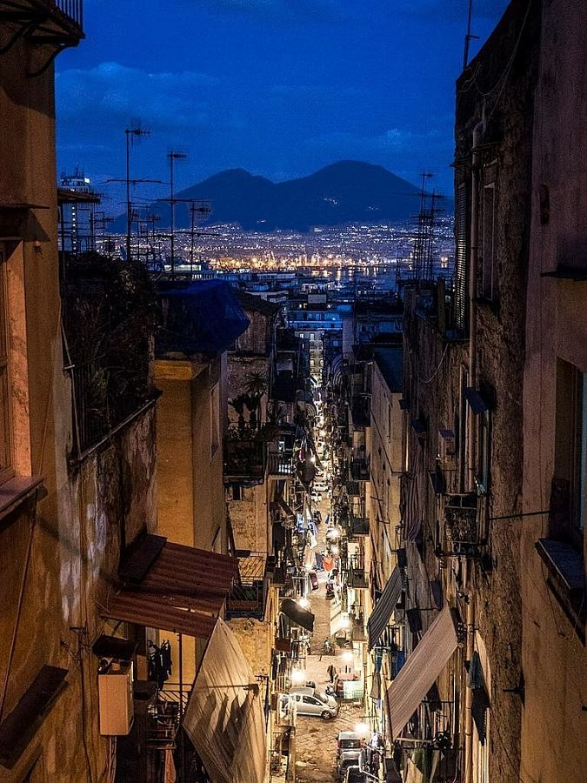
Additional information
Fee: 250 € (meals,accomodation,
transport,places of interest).
20 places available.

Slide 14
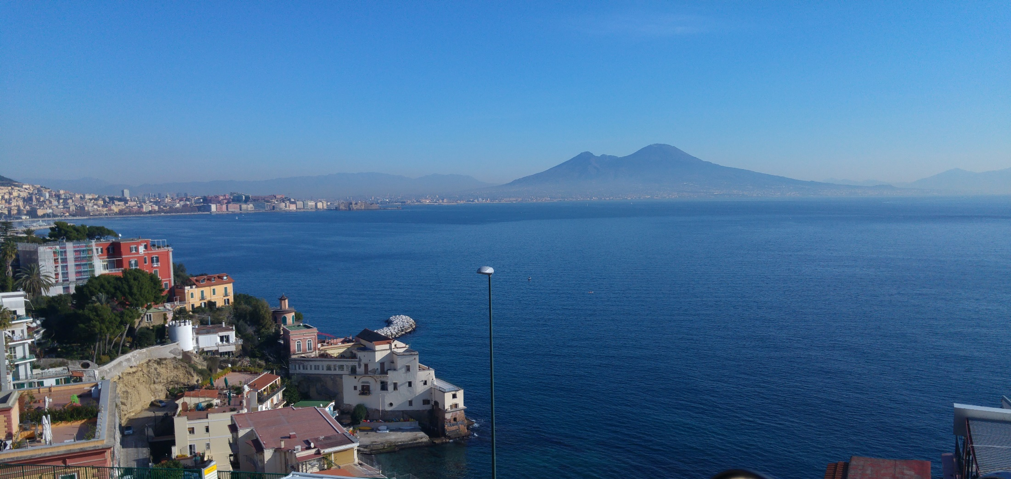
“The Italian proverb says “See Naples and die” but I say, see Naples and live; for there seems a great deal worth living for.” Arthur John Strutt

